Slide 1
TCHHN Disease Specific Special Certification programs
Advanced Heart Failure
VAD
Palliative Care
Primary Stroke Care
Inpatient Diabetes Care
- Metabolic and Bariatric surgery Program

Slide 2
Special Certification Program Components
Structure
Survey every two years
Processes
Adoption of Clinical Practice Guidelines (CPG)
Outcomes
Standardized performance measures
Disease Specific / Patient Population focused
Medical Director
Clinical Director/ Manager
Core Interdisciplinary Team
Evidenced based care to guide clinical practice
Order sets
Protocols
Patient Satisfaction
Organized Quality Assessment Performance Improvement (QAPI) meetings
Improved Throughput
Promotes TCHHN programs

Slide 3
Advanced Heart Failure Program Specifics
Heart Link Coordinators: (Two RNs)
Purpose is to screen, educate, and follow up during and after hospitalization
Statistically track and trend measurements to improve care for Heart Failure population
“Possible/probable heart failure patients” include:
Obvious ICD codes which mention acute and/or chronic HF
BNP >300, noted pleural effusion or vascular congestion, chronic renal failure with hypertension, and history of Heart Failure
Consider Heart Failure Service consult when using IV diuretics or new onset Heart Failure
Order Sets:
Use “CHF Order Set” for admission or “CHF Add on” order set
Include consults for Heart Link Coordinators, Nutrition, Case Management, Advance Directives/ Advanced Care Planning & Cardiac Rehab
Strict intake and output, daily weights, education
7 Day Follow Up:
Must have a follow-up visit WITHIN 7 DAYS of discharge (Heart Failure MD, Primary Care Physician {PCP} OR Nurse Practitioner)
IF unable to schedule within 7 days, an MD or NP must write a note stating a reason
Some providers have access to a .7 (dot seven) smart phrase to assist in documentation

Slide 4
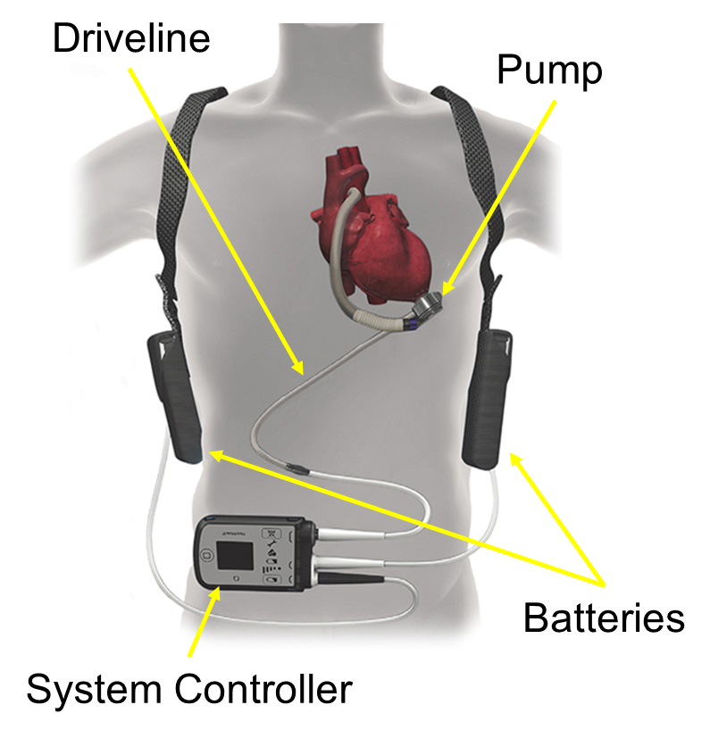
LEFT VENTRICULAR ASSIST DEVICE (LVAD) PROGRAM SPECIFICS
The Christ Hospital heart failure physician team evaluates patients for both heart transplant and left ventricular assist device (LVAD).
Indications for LVAD therapy include:
Bridge to Transplant (BTT): supports heart function while patient is awaiting a heart transplant
Destination Therapy (DT): therapy for patients that are not a candidate for heart transplant at the time of implant
When to refer to an advanced heart failure specialist:
I IV Inotropes
N NYHA IIIB/IV or persistently elevated natriuretic peptides
E End-organ dysfunction (liver, kidney, mental status)
E Ejection fraction ≤ 30%
D Defibrillator shocks
H Hospitalizations > 1
E Edema despite escalating diuretics
L Low blood pressure, high heart rate
P Progressive intolerance or down-titration of guideline directed medical therapy
Also, refer patients for more than moderate mitral regurgitation.
To refer a patient for heart transplant or LVAD evaluation, place a consult to the heart failure physicians (inpatient) or call 513-585-4944 (outpatient).
2017 ACC Expert Consensus Decision Pathway for Optimization of Heart Failure Treatment: Answers to 10 Pivotal Issues About Heart Failure With Reduced Ejection Fraction
http://www.onlinejacc.org/content/early/2017/12/12/j.jacc.2017.11.025

Slide 5
Palliative Care Program Specifics
Palliative care is specialized medical care focused on the symptoms and stress of a serious illness. Patients can have a curable serious illness with active treatment of disease and still get palliative care.
Palliative Care can help with:
Complex medical decision making (like prognosis and goals of care discussions)
Contacting the Palliative Care Team:
Available in the hospital 24/7
An Outpatient Palliative Care Clinic is available for patients with Cancer and LVADs
Referrals can be placed through Epic
Call 585-4157 to contact the team
Advance care planning (like code status)
Pain and symptom management
Psychosocial and Spiritual suffering
Comprehensive Palliative Care program – including physicians, APRNs, RNs, social workers, chaplains, and pharmacists

Slide 6
Primary Stroke Care Program Specifics
Includes ischemic stroke, non-traumatic hemorrhagic stroke, and TIA
Caring for Primary Care Stroke Patients :
Use of Primary Stroke Order Sets: Stroke Add On, ICU Hemorrhagic, Subarachnoid Hemorrhagic, Code Stroke
Contacting the Primary Care Stroke Team:
UCMC Comprehensive Stroke Program Relationship Call 119 to initiate assessment
Reduces delays due to inconsistent or incomplete orders
Code Stroke Algorithm: Activate by Calling 119
Emergency Department
Inpatients
Optimizes the prompt assessment and management of patients with stroke symptoms that lead to faster stroke interventions and are associated with better outcomes
Expert consulting for FASTER recognition of IV Alteplase administration (Goal < 60 minutes) and/or transfer for thrombectomy and other neurovascular procedures (Goal < 150 minutes)
Tele stroke capabilities

Slide 7
Inpatient Diabetes Program Specifics
Hospital Blood Glucose Target: 100- 180 mg/dl
Caring for Inpatient Diabetes Patients :
Utilize Basal Bolus Order Set
Contacting the Inpatient Diabetes Program Team:
Inpatient diabetes education consult in EPIC if needed
Order A1C if no current A1C available
Document type of diabetes and diabetes control in daily progress note
All patients with diabetes should have POCT glucose orders
Order basal/bolus insulin
For bolus insulin: order mealtime plus correction scale rapid acting insulin
Review blood glucose daily and adjust insulin as needed
Endocrinology consult for all insulin pump patients and for U-500 Regular insulin
Inpatient nutrition education consult in EPIC if needed
Consider Hospitalist or Endocrinology consult for diabetes management

Slide 8
Additional Accreditation Program: Metabolic and Bariatric surgery Program
Nationwide accreditation and quality improvement program for the treatment of metabolic and bariatric patients
In-hospital mortality rates at accredited centers are more than three times lower than the mortality rates at non-accredited centers
To be eligible and maintain accreditation the center must perform a minimum of 50 bariatric stapling procedures annually on patients 18 years of age or older
Multiple studies have examined patient safety in metabolic and bariatric surgery and support the value of accreditation
The American College of Surgeons (ACS) and the American Society for Metabolic and Bariatric Surgery (ASMBS) provide standards for the Metabolic and Bariatric Surgery Accreditation and Quality Improvement Program (MBSAQIP®)
Initial accreditation on site survey as a Comprehensive Center is scheduled to occur April-June, 2020

