Slide 1

TCHHN Joint Commission Disease Specific Care Certification programs
Advanced Heart Failure
VAD
Palliative Care
Primary Stroke Care
Inpatient Diabetes Care

Slide 2
Special Certification Program Components
Structure
Survey every two years
Processes
Adoption of Clinical Practice Guidelines (CPG)
Outcomes
Standardized performance measures
Disease Specific / Patient Population focused
Medical Director
Clinical Director/ Manager
Core Interdisciplinary Team
Evidenced based care to guide clinical practice
Order sets
Protocols
Patient Satisfaction
Organized Quality Assessment Performance Improvement (QAPI) meetings
Improved Throughput
Promotes TCHHN programs

Slide 3

Advanced Heart Failure Program requirements
Updated 2022 AHA/ACC/HFSA Clinical Practice Guidelines for Management of Heart Failure
“CHF” or “CHF ADD ON” Order Sets
Include consults for Heart Link Coordinators, Nutrition, Case Management, Advance Directives/ Advanced Care Planning & Cardiac Rehab
Documentation of NYHA Classification
Must have a follow-up visit WITHIN 7 DAYS of discharge (Heart Failure MD, Primary Care Physician {PCP} OR Nurse Practitioner) & must be documented on the Discharge Instructions / AVS
RN to notify if appointment is outside 7 Day window and MD or APP MUST document reason in note
Strict intake and output, daily weights, sodium restricted diet (2gm)
Consider Heart Failure Service consult
Clinical Practice Guidelines require the documentation of NYHA classification in Discharge Summary
Pre-selected labs important for care of HF patients
Enter an ‘IP Consult to Miscellaneous’ with the comment “7 day HF follow up” close to discharge will prompt the HUC to make the follow up appointment.
7 Day Follow Up Appointment:
LVEF <30%
Worsening renal or liver failure with symptoms of HF
Recurrent admissions for HF
Clinical Practice Guidelines recommend referral to a HF specialty team when
Call the Heart Link Coordinators with any questions at

Slide 4
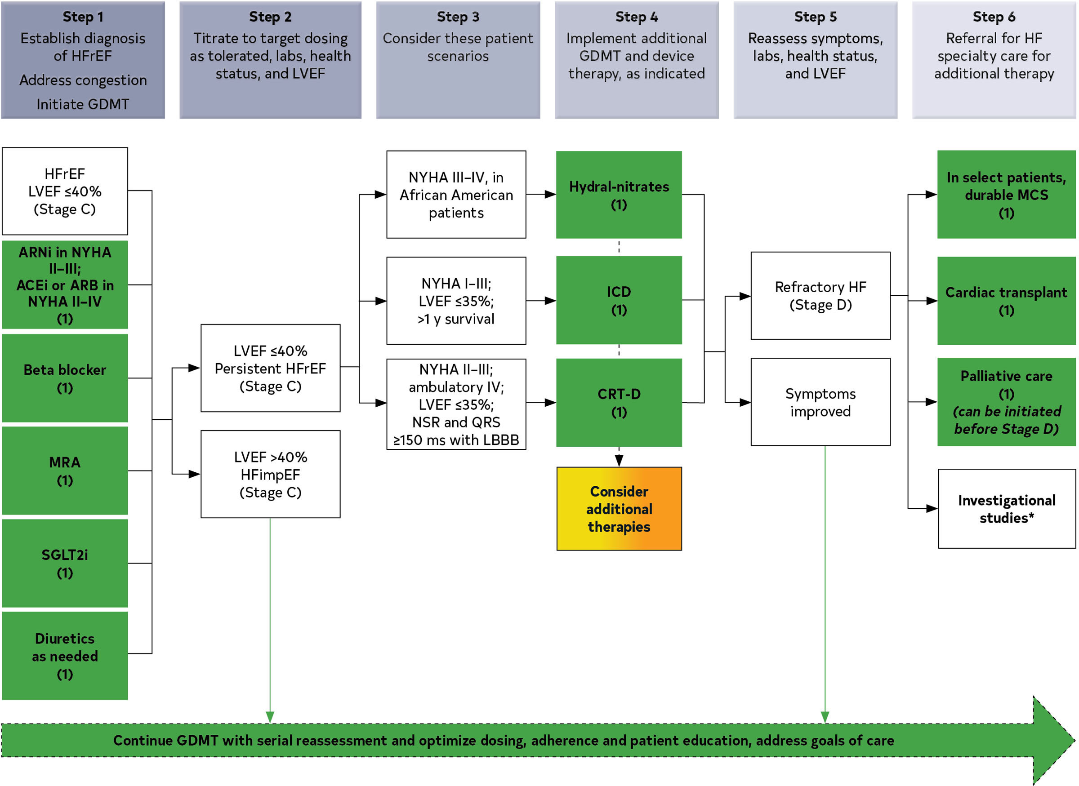
GDMT reduced ejection fraction
Updated 2022 AHA/ACC/HFSA Clinical Practice Guidelines for Management of Heart Failure

Slide 5
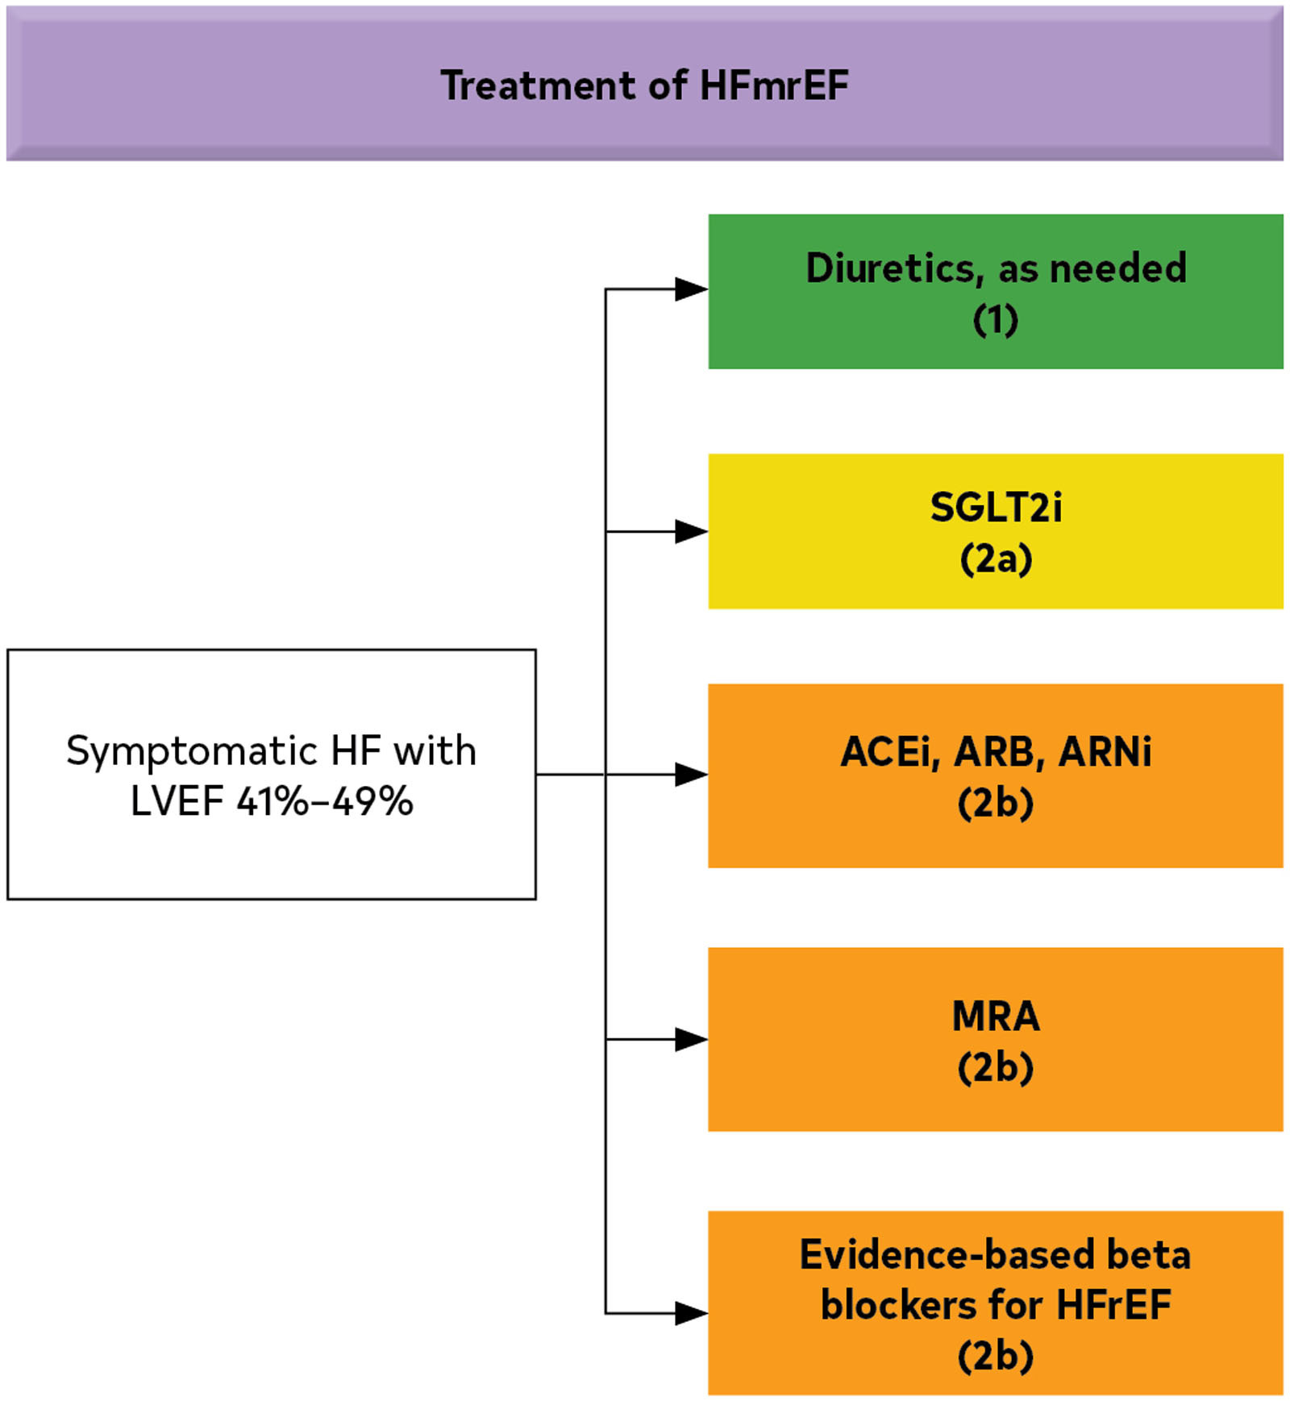
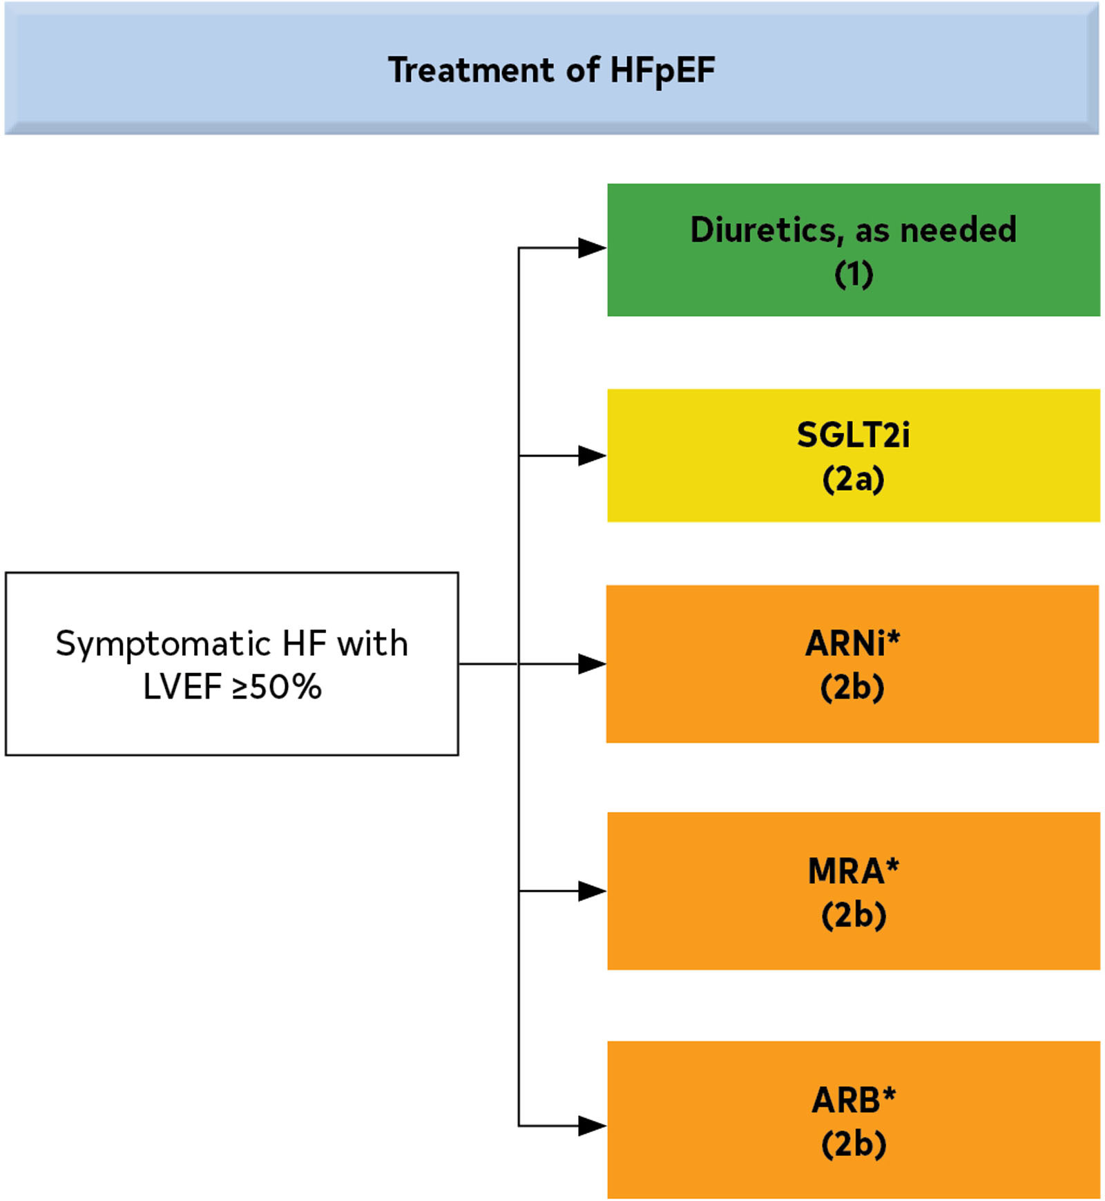
GDMT moderately reduced and preserved ejection fraction
Updated 2022 AHA/ACC/HFSA Clinical Practice Guidelines for Management of Heart Failure

Slide 6
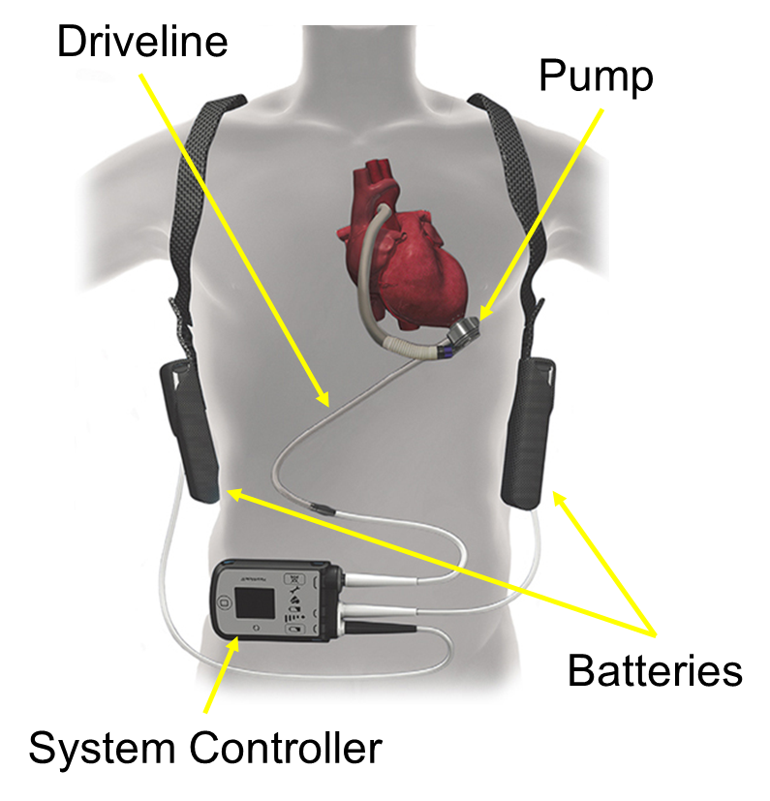
LEFT VENTRICULAR ASSIST DEVICE (LVAD) PROGRAM SPECIFICS
The Christ Hospital heart failure physician team evaluates patients for both heart transplant and left ventricular assist device (LVAD).
Indications for LVAD therapy include:
Bridge to Transplant (BTT) / short-term: supports heart function while patient is awaiting a heart transplant
Destination Therapy (DT) / long-term: therapy for patients that are not a candidate for heart transplant at the time of implant
When to refer to an advanced heart failure specialist:
I IV Inotropes
N NYHA IIIB/IV or persistently elevated natriuretic peptides
E End-organ dysfunction (liver, kidney, mental status)
E Ejection fraction ≤ 30%
D Defibrillator shocks
H Hospitalizations > 1
E Edema despite escalating diuretics
L Low blood pressure, high heart rate
P Progressive intolerance or down-titration of guideline directed medical therapy
Also, refer patients for more than moderate mitral regurgitation.
To refer a patient for heart transplant or LVAD evaluation, place a consult to the heart failure physicians (inpatient) or call 513-585-4944 (outpatient). For additional provider education regarding the LVAD, call 513-585-0809.
2017 ACC Expert Consensus Decision Pathway for Optimization of Heart Failure Treatment: Answers to 10 Pivotal Issues About Heart Failure With Reduced Ejection Fraction
http://www.onlinejacc.org/content/early/2017/12/12/j.jacc.2017.11.025

Slide 7
Palliative Care Program Specifics
Palliative care is specialized medical care for people living with a serious illness. It is focused on providing relief from the symptoms and stress of an illness. The goal is to improve quality of life for both the patient and family. Palliative care is provided by a specially-trained team of doctors, nurses, pharmacists, chaplains, and social workers. Care is based on the need of the patient, not the prognosis. It is appropriate at any age and any stage of a serious illness and can be provided along with curative treatment.
It is the standard of care at The Christ Hospital for patients with stage IV cancer and LVADs to have palliative care consultation during a hospital stay.
Palliative Care can help with:
Complex medical decision making (like prognosis and goals of care discussions)
Contacting the Palliative Care Team:
Physicians are available 24/7
Outpatient Palliative Care Clinic is available for patients with Cancer and LVADs
Consults can be placed through Epic
Call 585-4157 to contact the team
Advance care planning (like code status and surrogate decision-making)
Pain and symptom management
Psychosocial and Spiritual suffering

Slide 8
Primary Stroke Care Program Specifics
Includes ischemic stroke, non-traumatic hemorrhagic stroke, and TIA
Caring for Primary Care Stroke Patients :
Use of Primary Stroke Order Sets: Stroke Add On, ICU Hemorrhagic, Subarachnoid Hemorrhagic, Code Stroke
Contacting the Primary Care Stroke Team:
UCMC Comprehensive Stroke Program Relationship Call 119 to initiate assessment
Reduces delays due to inconsistent or incomplete orders
Code Stroke Algorithm: Activate by Calling 119
Emergency Department
Inpatients
Optimizes the prompt assessment and management of patients with stroke symptoms that lead to faster stroke interventions and are associated with better outcomes
Expert consulting for FASTER recognition of IV Alteplase administration (Goal < 60 minutes) and/or transfer for thrombectomy and other neurovascular procedures (Goal < 150 minutes)
Tele stroke capabilities

Slide 9
Primary Stroke Care Program Specifics
The program develops a standardized process originating in clinical practice guidelines (CPGs) or evidence-based practice to deliver or facilitate the delivery of clinical care. The program demonstrates evidence that it is following the clinical practice guidelines when providing care, treatment, and services.
• The program must demonstrate evidence that it is following the clinical practice guidelines when providing care, treatment, and services as evidenced by using fluid recommended for Acute Ischemic Stroke of normal saline. If a different fluid is selected to treat the patient the provider must document in the EMR the reason for the change of fluids
• Primary Stroke Program CPG’s are located on MYTCH -Departments-Stroke Program-Clinical Resources-Open Clinical Practice Guidelines.docx
• Use of Primary Stroke Order Sets: Stroke Add On, ICU Hemorrhagic, Subarachnoid Hemorrhagic, Acute Ischemic Stroke reduces delays due to inconsistent or incomplete orders
• The use of standardized stroke care order sets is recommended
to improve general management

Slide 10
INTRAVENOUS FLUIDS CLINICAL PRACTICE GUIDELINES
• Patients presenting with acute ischemic stroke are predominantly either euvolemic or hypovolemic
• Hypovolemia may predispose to hypoperfusion and exacerbate the ischemic brain injury, cause renal impairment, and potentiate thrombosis. Hypervolemia may exacerbate ischemic brain edema and increase stress on the myocardium. Thus, euvolemia is desirable
• For patients who are euvolemic at presentation, clinicians should initiate maintenance intravenous fluids
• A substantial proportion of hypotonic solutions, such as 5% dextrose (after the glucose is metabolized) or 0.45% saline, is distributed into the intracellular spaces and may exacerbate ischemic brain edema. Isotonic solutions such as 0.9% saline are more evenly distributed into the extracellular spaces (interstitial and intravascular) and may be better for patients with acute ischemic stroke
• Hypovolemia should be corrected with intravenous normal saline, and cardiac arrhythmias that might be reducing cardiac output should be corrected
• If a different fluid is selected to treat the patient the provider must document in the EMR the reason for the change of fluids

Slide 11
Inpatient Diabetes Program Specifics
Hospital Blood Glucose Target: 100- 180 mg/dl
Caring for Inpatient Diabetes Patients :
Utilize Basal Bolus Order Set
Contacting the Inpatient Diabetes Program Team:
Inpatient diabetes education consult in EPIC if needed
Order A1C if no current A1C available
Document type of diabetes and diabetes control in daily progress note
All patients with diabetes should have POCT glucose orders
Order basal/bolus insulin
For bolus insulin: order mealtime plus correction scale rapid acting insulin
Review blood glucose daily and adjust insulin as needed
Endocrinology consult for all insulin pump patients and for U-500 Regular insulin
Inpatient nutrition education consult in EPIC if needed
Consider Hospitalist or Endocrinology consult for diabetes management

